Slide 1
Essentials of British Culture
Chapter 11
The Press, Radio and Television

Slide 2
The British Press
The number of newspapers sold, in relation to population, is higher in Britain than in any other country except Sweden.
In other developed countries like Japan and the US, newspaper reading is mainly a middle-class habit, but in Britain the ‘lower classes’ are also regular readers.
There are over 1400 different newspapers which cater for a wide range of political views, interests and levels of education.

Slide 3
national newspapers
The press is mostly owned by one of about five large organisations.
Britain has two kinds of national newspapers: the quality papers and the tabloids.

Slide 4
the quality papers
The qualities are often called broadsheets (大报) because they are printed on large pages.
They report national and international news and are serious in tone.
They have editorials (社论) which comment on important issues and reflect the political views of the paper’s editor.

Slide 5
the quality papers
They also contain financial and sports news, obituaries (讣告), listings of television and radio programmes, theatre and cinema shows, a crossword (填字游戏), comic strips (连环漫画), advertisements and the weather forecast.

Slide 6
main quality dailies
The Times 《泰晤士报》：the most famous, the paper of the ‘establishment’(当权派）， politically it is independent, more sympathetic to the Conservative Party)
The Guardian 《卫报》(politically it is radical, sympathetic to the Labour Party)
Daily Telegraph 《每日电讯报》(very close to being an organ of the Conservative Party)
the Independent 《独立报》
the Financial Times 《金融时报》

Slide 7
the tabloids
The tabloids have a smaller page size and report news in less depth.
They deal in scandals and gossip, usually about famous people, whether in politics, sports or entertainment.
Also, they carry lots of crime and sensational stories.
Notes:
通俗小报

Slide 8
the tabloids
Some have page-three girls (三版女郎), photographs of half-naked young women.
Many people disapprove of the tabloids, and they are sometimes called the gutter press (主要刊载性与犯罪的低级趣味的报刊).

Slide 9
most popular tabloids
Sun 《太阳报》
Mirror 《镜报》
Express 《快报》
Daily Mail 《每日邮报》
the News of the World 《世界新闻报》, a Sunday tabloid, sells more copies than any other newspaper in Britain.

Slide 10
 | quality newspapers | the tabloids
cost | Daily---about 45 pence Sunday---about ₤1.30 pence | Daily---about 35 pence Sunday---about 90 pence
content | long informative articles, wide range of topics | human interest stories, sensational stories, less news, little discussion, little international news
style | objective presentation, less sensational or emotive language, wide vocabulary and complex syntax, less visual support | easy to read, sensational tone, emotive language, photographs and visuals

Slide 11
 | quality newspapers | the tabloids
purpose | to inform about national and international affairs | to entertain, provide gossip about stars, politicians
readership | the middle-class, professional and managerial jobs | the middle or lower class, clerical, skilled or unskilled workers, unemployed and old people

Slide 12
Local newspapers
Many local newspapers are weeklies (published once a week 周报).
They contain news of local events and sport, carry advertisements for local businesses, and give details of houses, cars and other items for sale.

Slide 13
Local newspapers
Local newspapers can often be of service to the community in expressing public feeling on local issues.
A newspaper can sometimes persuade the council to take action to provide better shopping facilities, improve transport in the area and preserve local monuments and places of interest.

Slide 14
Periodicals
The Economist: mildly radical, devoted to American affairs, seriously attempts to comment on every event of any political or economic interest
The New Statesman
The Spectator
New Society

Slide 15


Slide 16

The British Broadcasting Corporation (BBC) is a UK-based international public service broadcaster headquartered at Broadcasting House in London. It is the world's oldest national broadcasting organisation and the largest broadcaster in the world by number of employees, with about 23,000 staff
AT A GLANCE

Slide 17

Most of the BBC's services in the UK are funded from income from the licence fee:
• 10 national television channels (BBC One, BBC Two, BBC Three, BBC Four, CBBC, CBeebies, BBC News, BBC Parliament, BBC Alba, BBC HD)
• BBC Red Button interactive TV
• 10 national radio stations (Radio 1, 1Xtra, Radio 2, Radio 3, Radio 4, Radio 4 Extra, Radio 5 Live, 5 Live Sports Extra, 6 Music, BBC Asian Network)
• National TV and radio services for Scotland, Wales and Northern Ireland, and over 40 local radio stations for England
• BBC Online
• BBC World Service
Around the world, there are separate commercial ventures whose profits help fund BBC public services, including BBC Worldwide, and BBC World News.
BBC services on television, radio and online

Slide 18
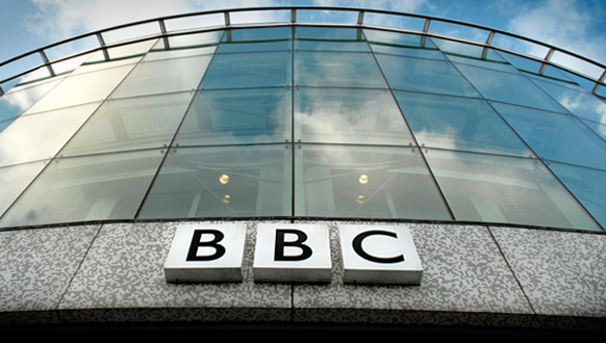
Mission and values
BBC's mission
To enrich people's lives with programmes
and services that inform,
educate and entertain.
BBC's value
•Trust is the foundation of the BBC: we are independent, impartial and honest.
•Audiences are at the heart of everything we do.
•We take pride in delivering quality and value for money.
•Creativity is the lifeblood of our organisation.
•We respect each other and celebrate our diversity so that everyone can give their best.
•We are one BBC: great things happen when we work together.

Slide 19

The Licence Fee
The annual cost of a colour TV licence is £145.50 (as from 1 April 2010). A black and white TV licence is £49.﻿﻿

